Slide 1
1. Parasitemia scatterplot

Slide 2
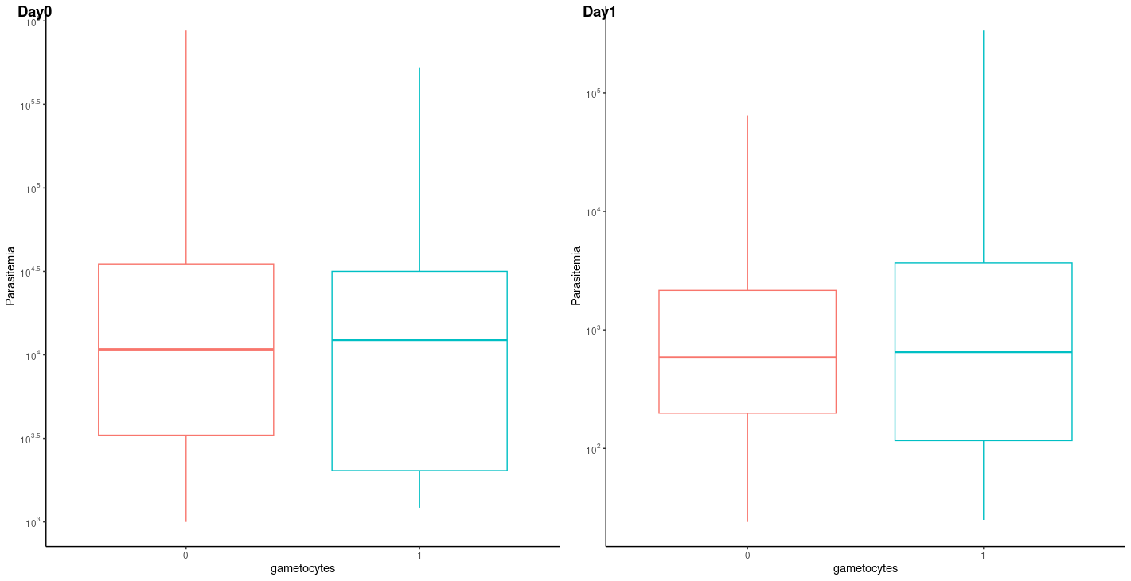
2. Boxplot on parasitemia with and without gametocytes
Without gametocytes
With gametocytes
Without gametocytes
With gametocytes

Slide 3
2. Boxplot on parasitemia with age categories
Age value | Age category
1 | 5 > x
2 | 5 – 10
3 | X > 10

Slide 4
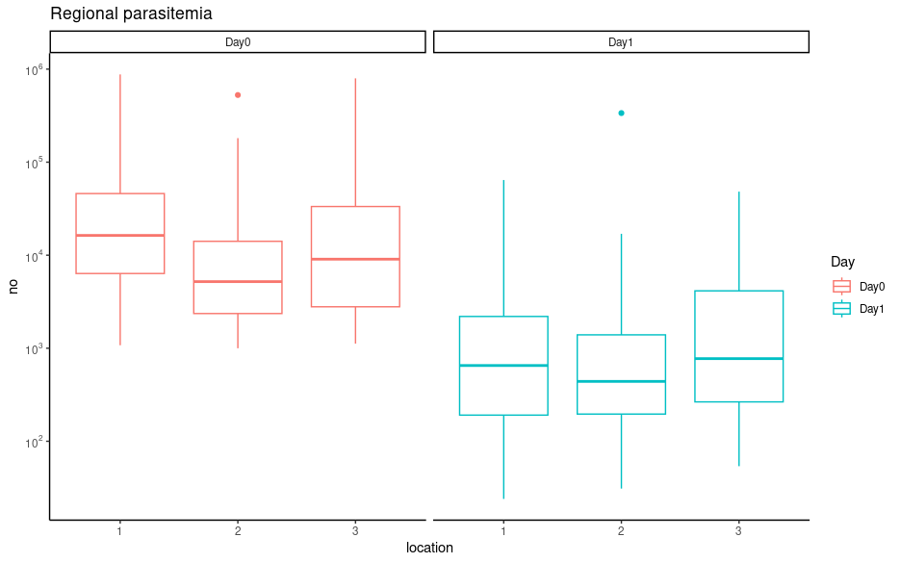
4. Boxplot on parasitemia with regions for both days
The color corresponds to the region
Alupe
Obekai
Amkura

